Slide 1
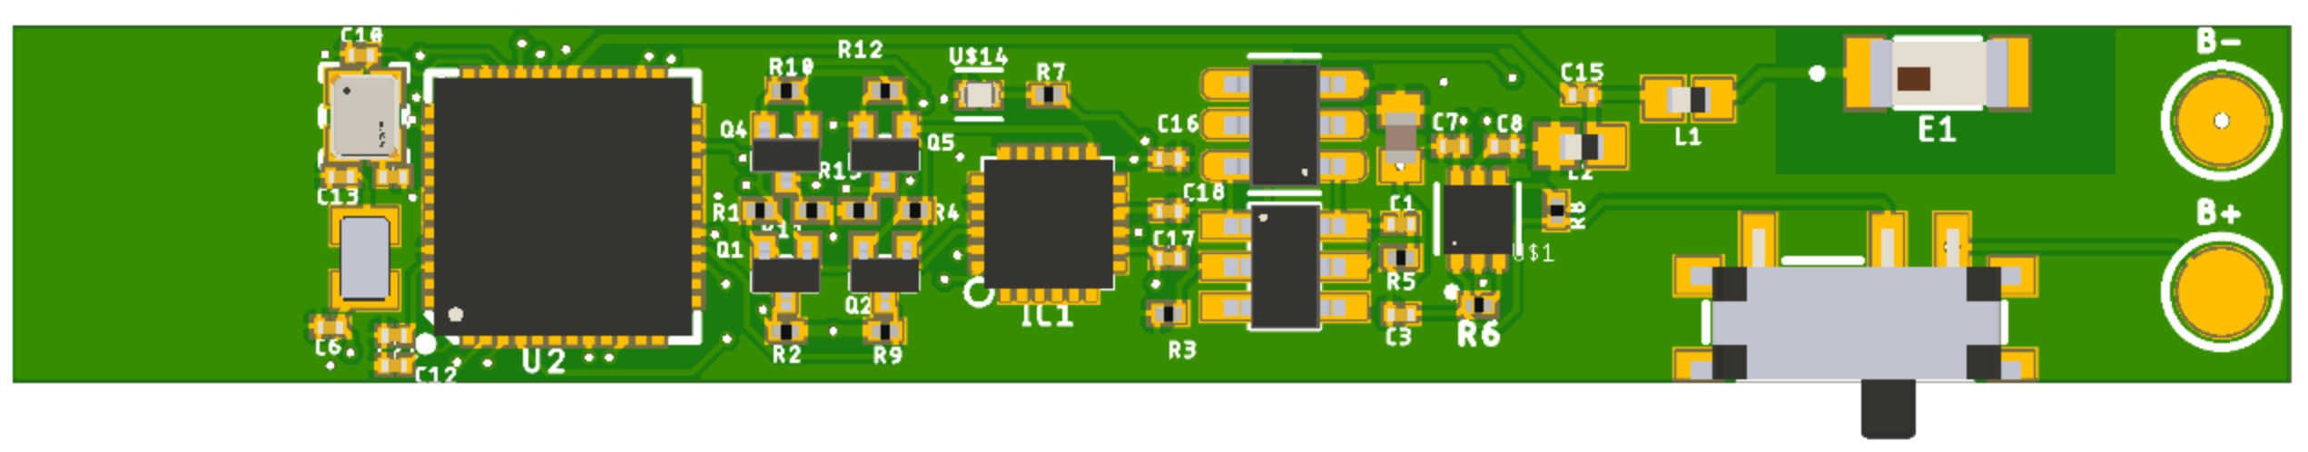
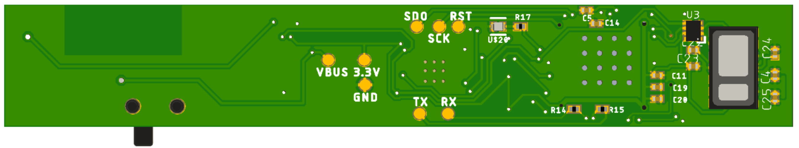

Slide 2
(a) Front of the Ring
(b)

Slide 3
32 MHz
NRF52832
chip LED
32 MHz
chip antenna
32.768 KHz
ICM20948
32 MHz
32 MHz
Slide
button
chip LED
IC
MAX30101

Slide 4
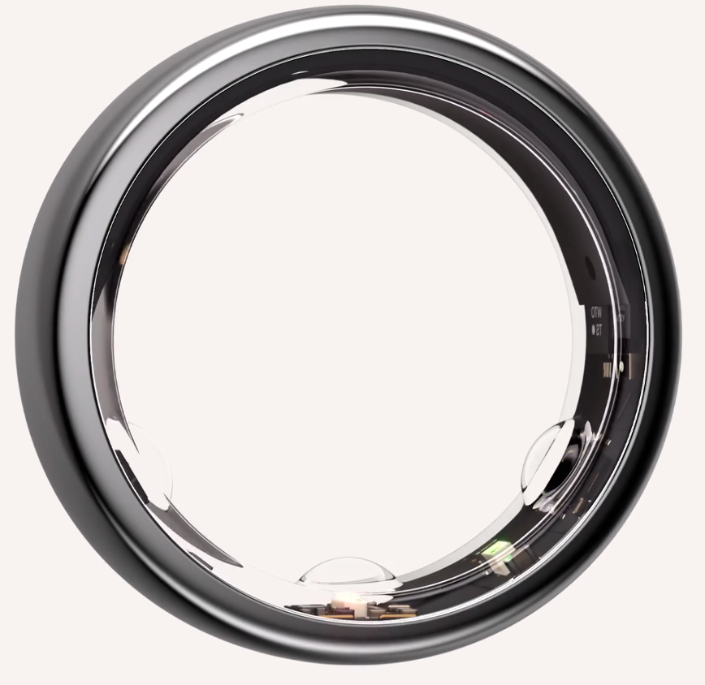
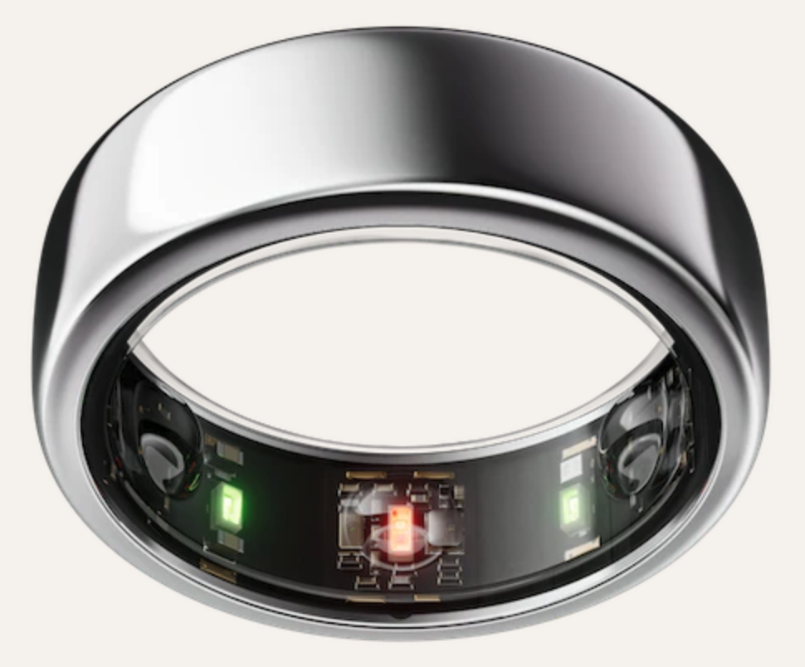
SMD Crystal
32.768 kHz
MCU
NRF52832
9-DOF IMU
ICM20948
Voltage Regulator
MIC5370
Chip Antenna
2450AT18B100E
LED
(a) Top
Power Protection
Slide Switch
SWD
Programming
(b) Bottom
Voltage Regulator
TXS0102DQE
PPG Sensor
MAX30101
(c) Front view
(d) Side view

Slide 5
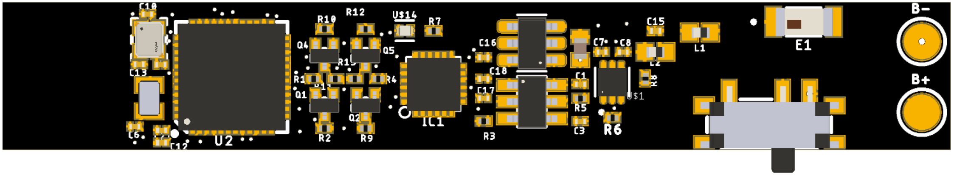
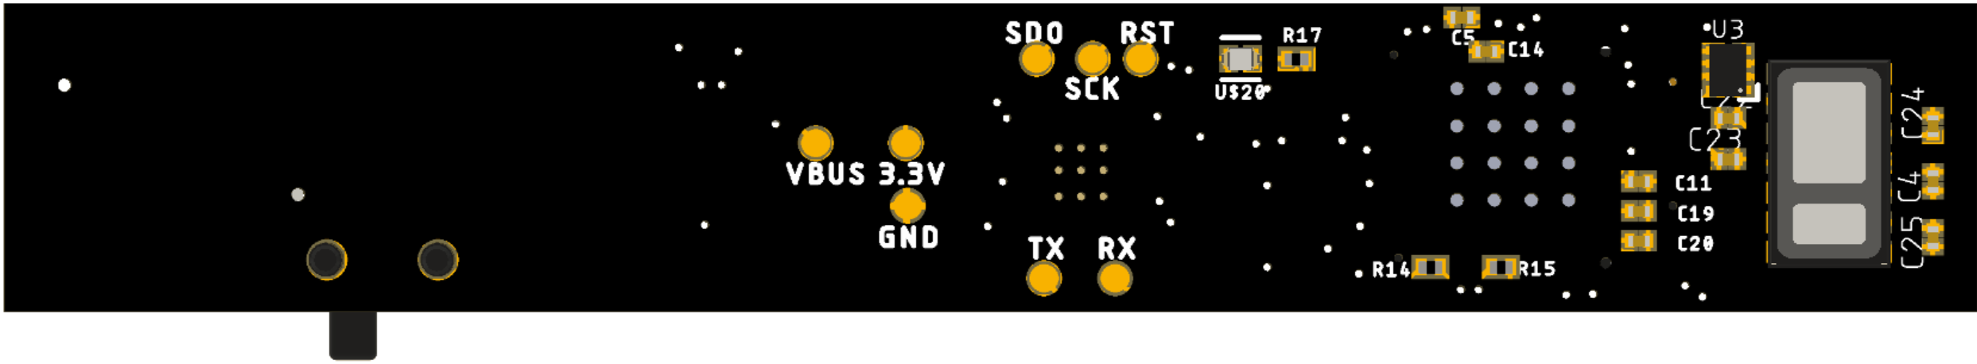
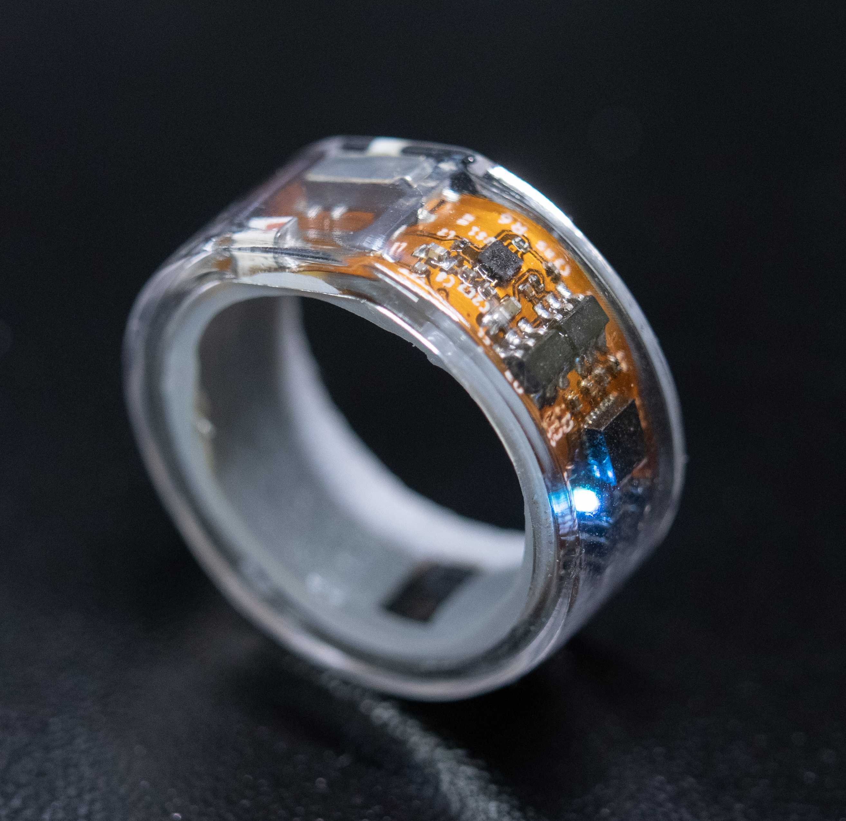
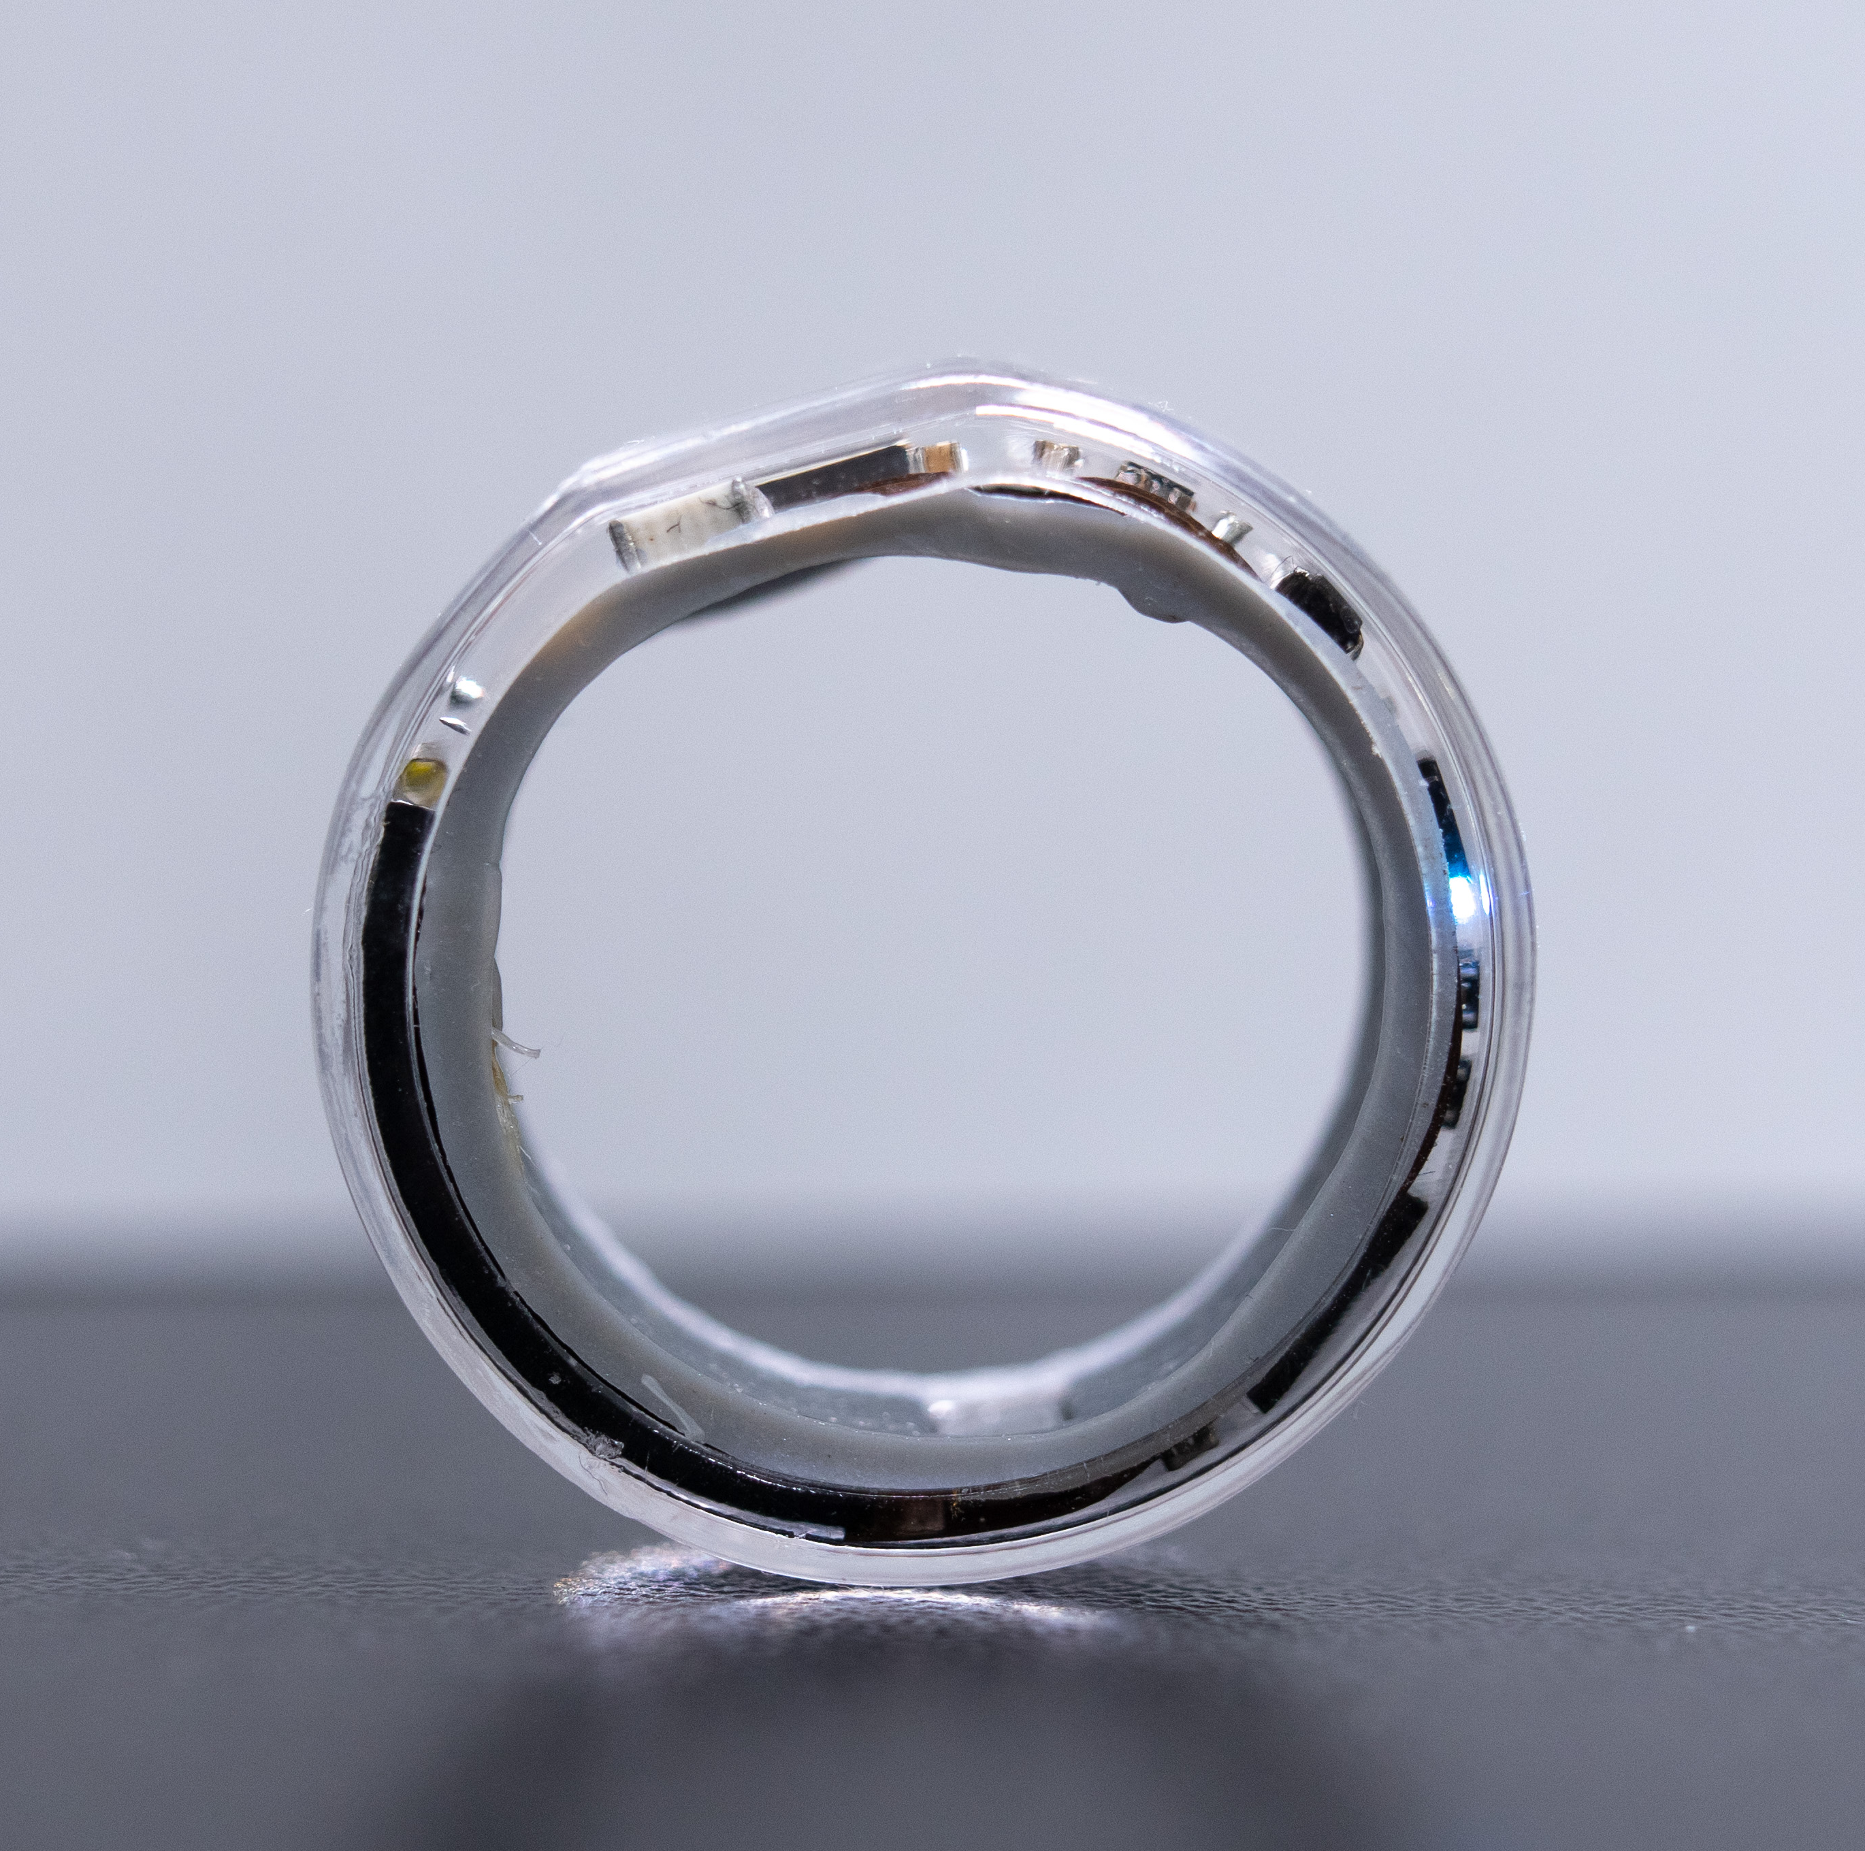
SMD Crystal
32.768 kHz
MCU
NRF52832
9-DOF IMU
ICM20948
Voltage Regulator
MIC5370
Chip Antenna
2450AT18B100E
LED
Power Pins
(a) Top
Power Protection
Slide Switch
SWD
Programming
(b) Bottom
Voltage Regulator
TXS0102DQE
PPG Sensor
MAX30101
(c) Front view
(d) Side view

